Slide 1
Project Proposals
Due next Monday (13th Feb) 11.59pm ET
2 page proposal (more details on “Course Logistics” document on canvas) + References
Today by 5pm ET, we will post:
  Project topics and some concrete problems
  Sample proposals and final reports from past iterations
  LaTeX and Word templates which you will use to write the proposal

Slide 2
Office Hours and Paper Presentations
Office hours switch this week
  Suraj and Jiaqi today
  Hima on Thursday
Students signed up for presentations next week should see us in office hours this week
  Full slide deck (ideally!)
  An overview of what you plan to present

Slide 3
Rule Based Approaches

Slide 4
Agenda
Paper 1: Interpretable Rule Lists (Letham et. al.)
Paper 2: Interpretable Rule Sets (Lakkaraju et. al.)
Discussion

Slide 5
Interpretable Classifiers Using Rules and Bayesian Analysis
Benjamin Letham, Cynthia Rudin, Tyler McCormick, David Madigan; 2015

Slide 6
Contributions
Introducing a generative model called Bayesian Rule Lists (BRL)
  Goal is to output a decision list (if then else-if)
Novel prior structure to encourage sparsity
Predictive accuracy on par with top algorithms

Slide 7
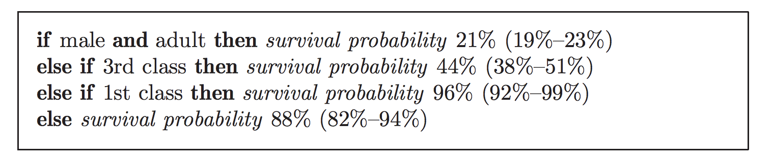
Decision List: Example
This is “an” accurate and interpretable decision list – possibly one of many such lists

Slide 8
Introduction: BRL
Produces a posterior distribution over permutations of if.. then.. Else-if.. rules from a large set of pre-mined rules
Decision lists with high posterior probability tend to be both accurate and interpretable
  Prior favors concise lists with small number of rules and fewer terms in left hand side

Slide 9
Introduction: BRL
New type of balance between accuracy, interpretability, and computation
What about using other similar models?
  Decision trees (CART)
  They employ greedy construction methods
  Not particularly computationally demanding but affects quality of solution – both accuracy and interpretability

Slide 10
Pre-mined Rules
A major source of practical feasibility: pre-mined rules
  Reduces model space
  Complexity of problem depends on number of pre-mined rules
As long as pre-mined set is expressive, accurate decision list can be found + smaller model space means better generalization (Vapnik, 1995)

Slide 11
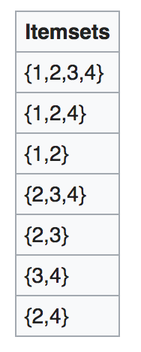
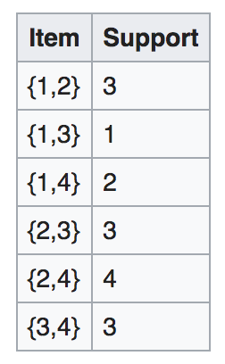
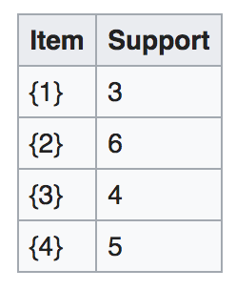
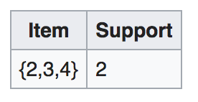
Pre-mined Rules: Intuition
Minimum Support = 3
This is Apriori algorithm. FP-growth is a single pass algorithm (more efficient)

Slide 12





Preliminaries: Notation
Training data:
Two labels: stroke or no stroke

Slide 13
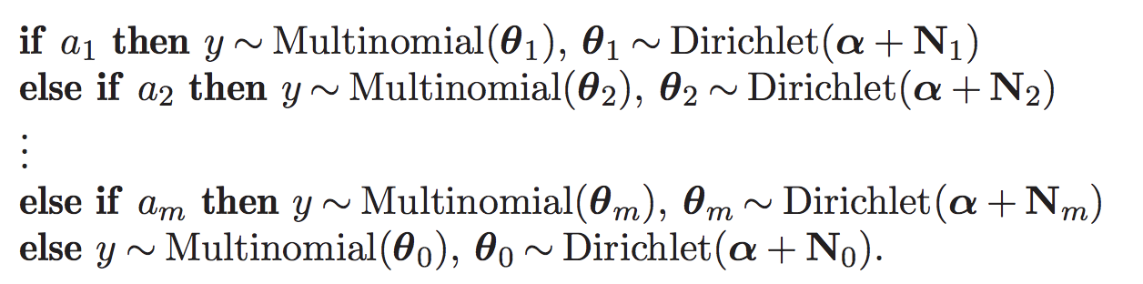

Bayesian Decision Lists
where

Slide 14
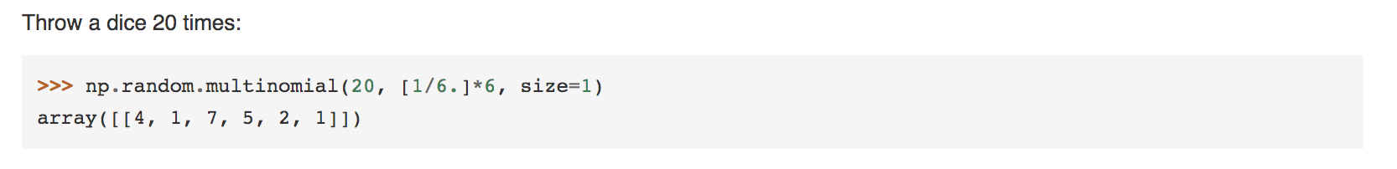
Preliminaries: Multinomial
Sampling from a multinomial:
Parameters are probability values

Slide 15
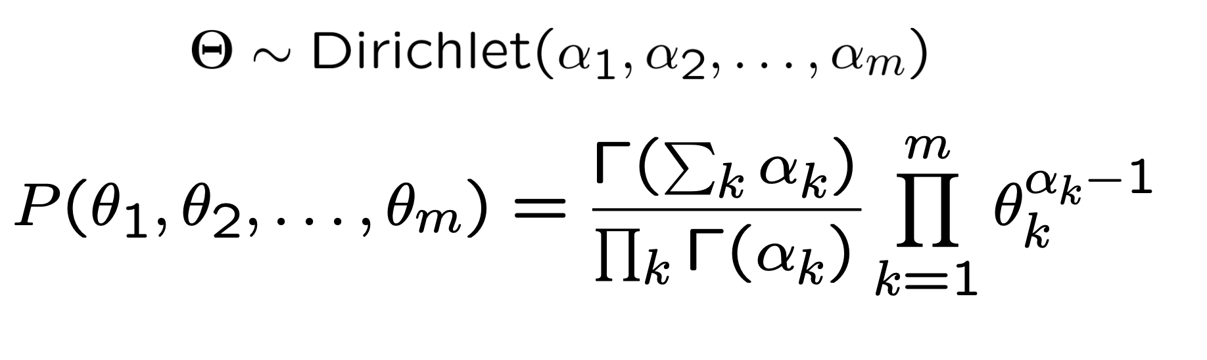
Preliminaries: Dirichlet
Dirichlet: sampling over a probability simplex
  E.g., (0.6, 0.4) is a sample from a Dirichlet distribution;
K-dimensional Dirichlet has k parameters – any positive number
  E.g., Dirichlet(60, 40)

Slide 16


Preliminaries: Dirichlet Prior
Conjugate prior for multinomial distribution
Conjugate prior: posterior in the same family as prior
Prior:
Posterior:

Slide 17




Bayesian Association Rules

Slide 18
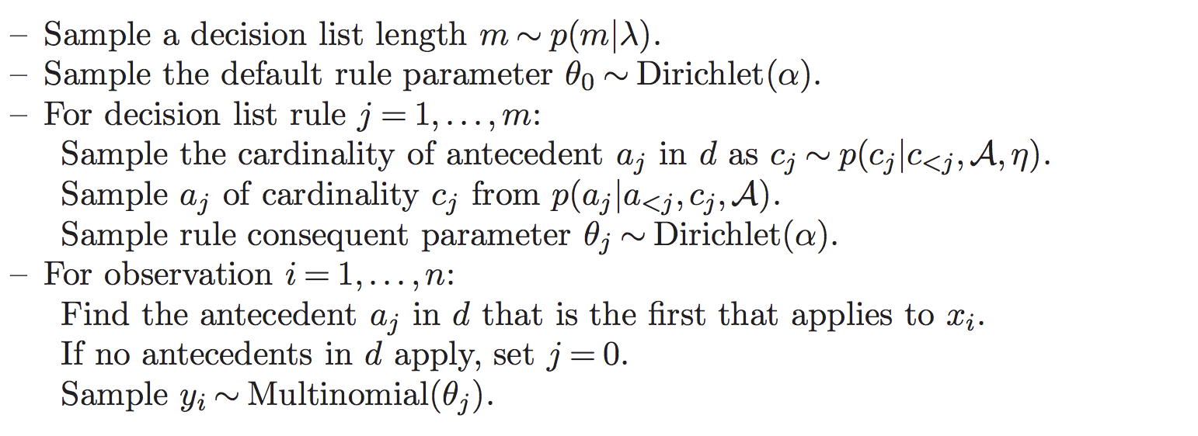

Generative Model
Our goal is to sample from the posterior distribution over antecedent lists:
is complete collection of pre-mined antecedents

Slide 19
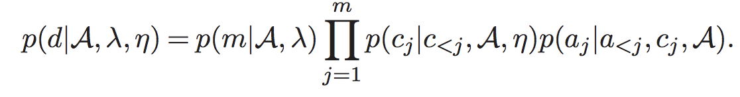
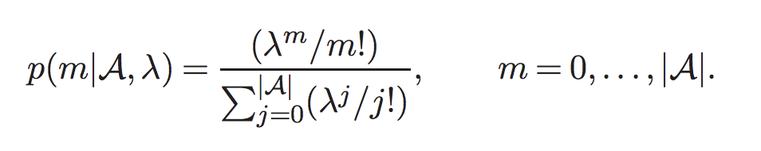
Prior Probabilities
Truncated Poisson:
Ensures that sampled values are within bounds!
Also, ensures expected value is close to
when there are a large number of pre-mined rules

Slide 20
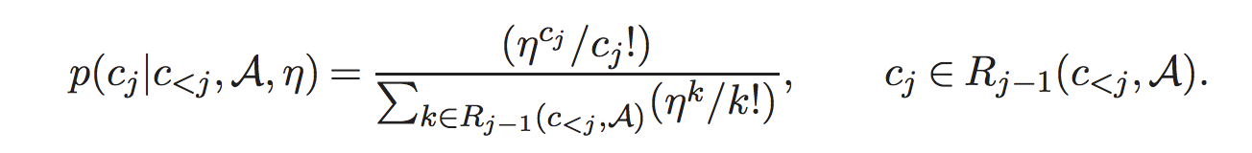

Prior Probabilities
Another Truncated Poisson,
is sampled uniformly from available antecedents with appropriate cardinality.

Slide 21
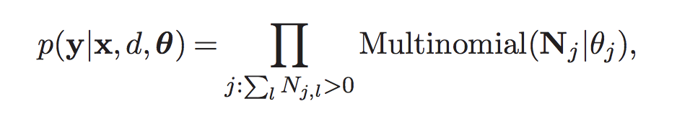


Likelihood
Likelihood is the product of multinomial probability mass functions for the observed label counts at each rule
Marginalize over → integrate out the intermediate parameter

Slide 22
Markov Chain Monte Carlo
Generate a chain of random samples until convergence
Each random sample is a stepping stone for the next one (chain)
New samples do not depend on any samples before the previous one (Markov)

Slide 23
Markov Chain Monte Carlo
How to go to (optimal) d* from current d^{t}
Move an antecedent to a different position in the list
Add an antecedent that is not currently in the list
Remove an antecedent from the list

Slide 24
Metropolis Hastings
Start with a random decision list
Choose a move based on “proposal distribution” Q
After you choose your move, you compute an acceptance probability A
Generate a random number u
If u <= A, then accept; otherwise reject

Slide 25
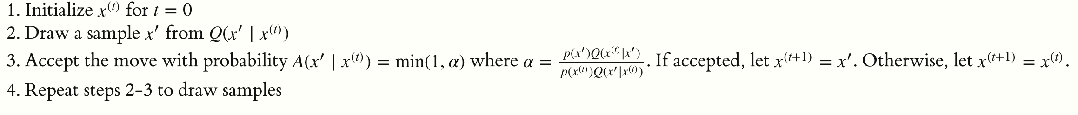

Metropolis Hastings

Slide 26
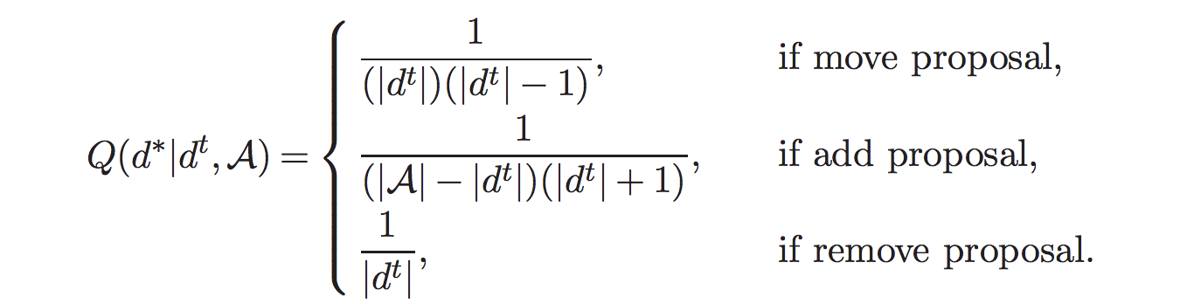
Proposal Probabilities
Move chosen uniformly
Which antecedents and their new position is also chosen uniformly

Slide 27
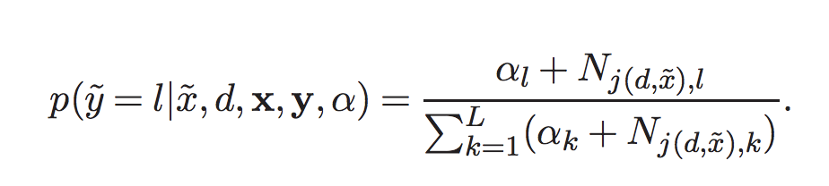
Estimating label of a new observation
Match the antecedent by looking at feature values of new observation

Slide 28
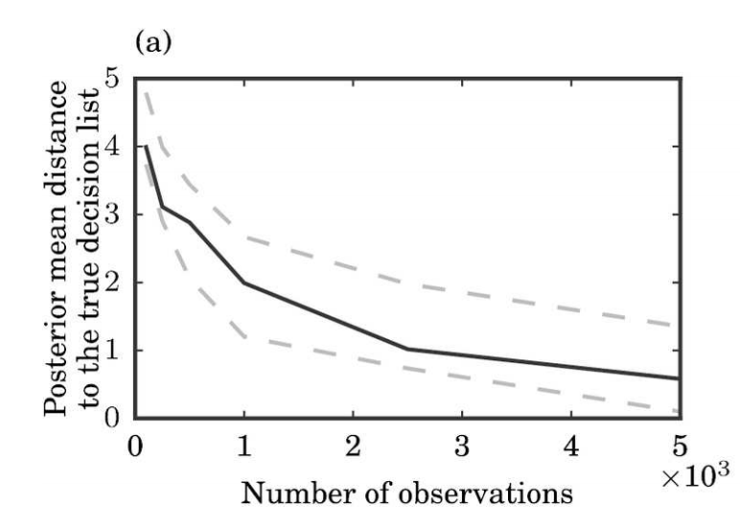
Simulation
Levenshtein edit distance – median value across 100 simulated datasets

Slide 29
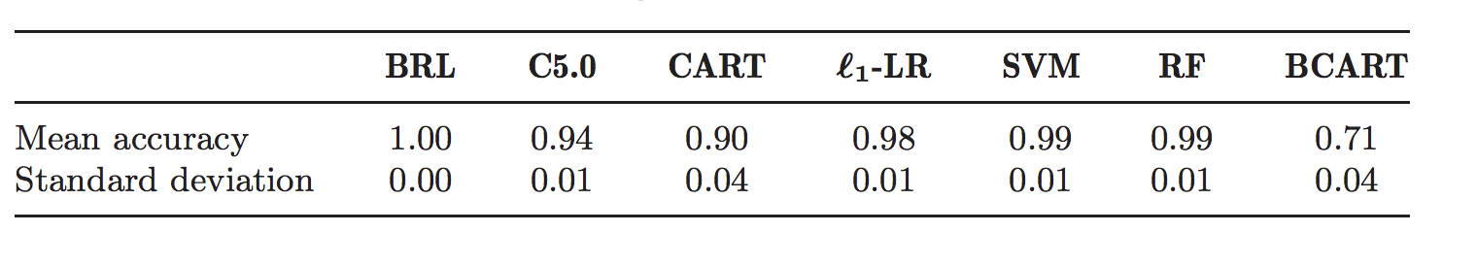
Tic-Tac-Toe
5 fold cross validation; accuracy computed across 5 folds

Slide 30
Stroke Prediction
N = 12,586, 14% had stroke
6000 times larger than data for CHADS2 score
Pre-mining: support 10% and max cardinality 2
5 fold evaluation

Slide 31
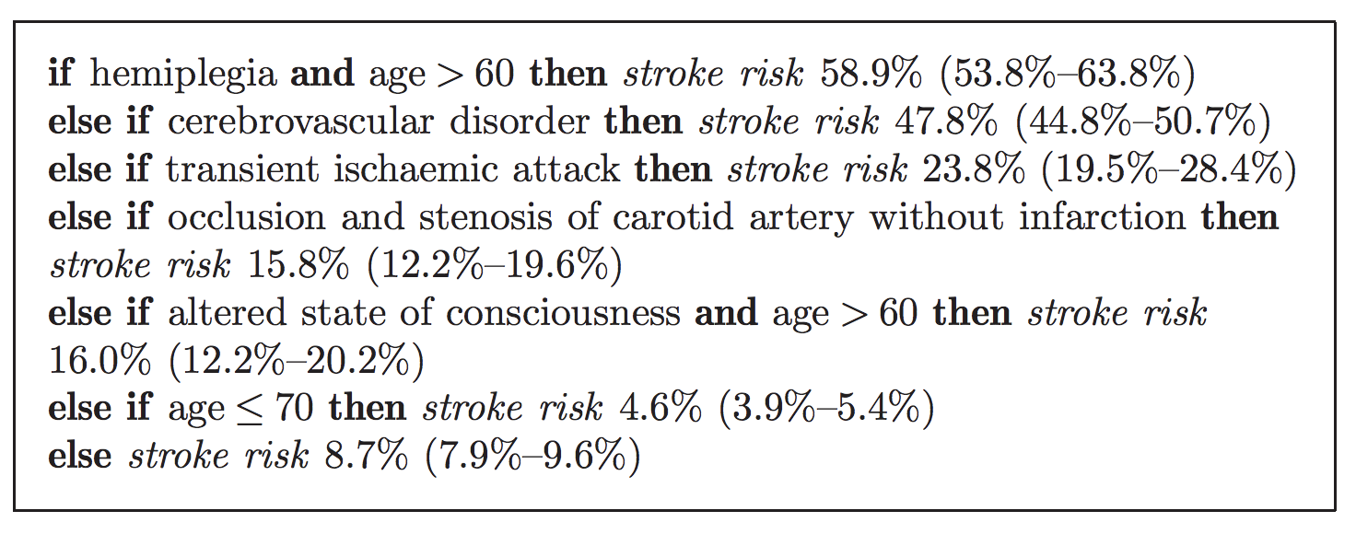
Stroke Prediction

Slide 32
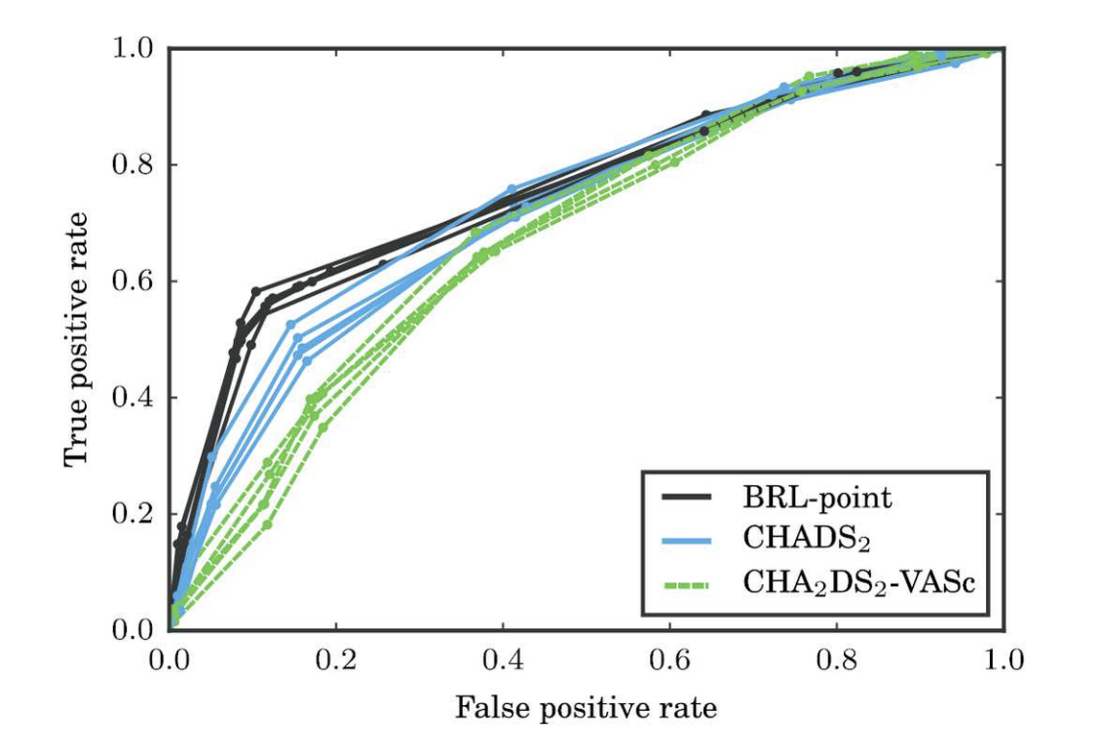
Stroke Prediction – ROC Curve

Slide 33
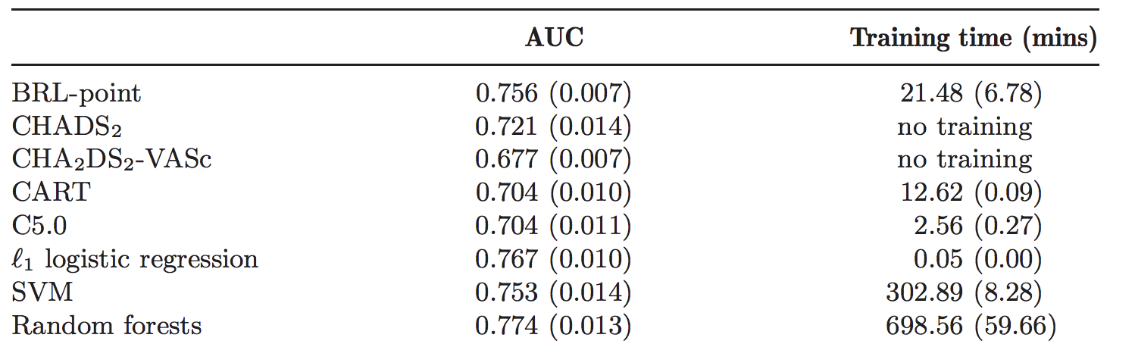
Stroke Prediction - AUC

Slide 34
Interpretable Decision Sets
Hima Lakkaraju, Stephen Bach, Jure Leskovec; 2016

Slide 35
Contributions
A framework called Interpretable Decision Sets (IDS) for classification
Novel objective function + proof of submodularity
Optimization procedure with optimality guarantees
Detailed metrics for evaluating interpretability + user studies

Slide 36
Motivation
Traditional classification models optimize for predictive accuracy
Very little understanding of the model itself and its predictions
Model being “readable” is not enough
Humans should be able to reason about predictions and readily explain the functionality of the model

Slide 37
Considerations
How do we define interpretability?
What kind of algorithmic solutions can effectively trade off interpretability and accuracy?
How can we ensure that humans are able to understand what the model is doing?

Slide 38
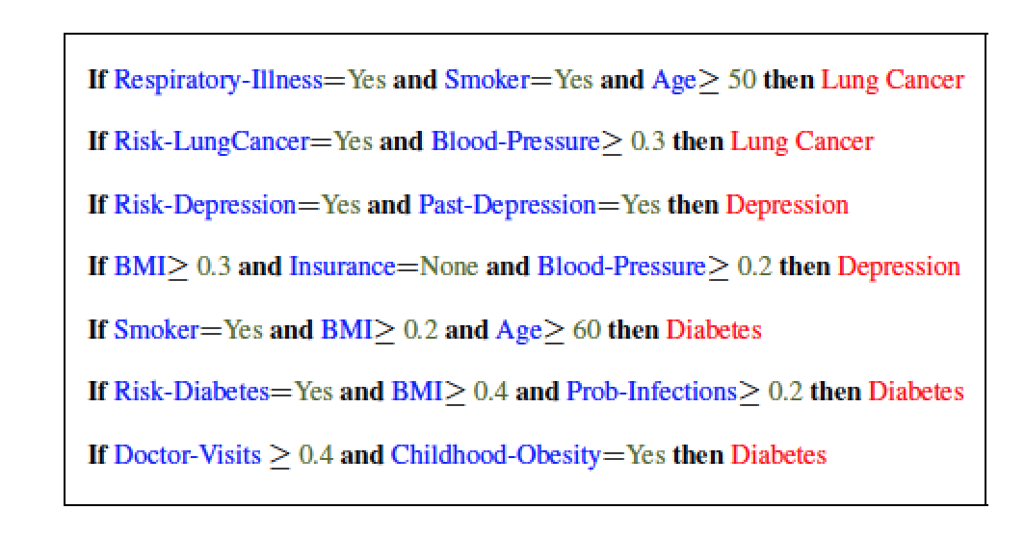
Decision Sets

Slide 39
Criteria for Interpretability
Parsimony: Fewer rules with fewer conditions
  Cognitive limits of human understanding
Distinctness: Minimal overlap of rules w.r.t the data points they cover
  No redundant and contradicting explanations of data points
Class Coverage: Explain all the classes in the data
  Rules explaining minority classes are important

Slide 40
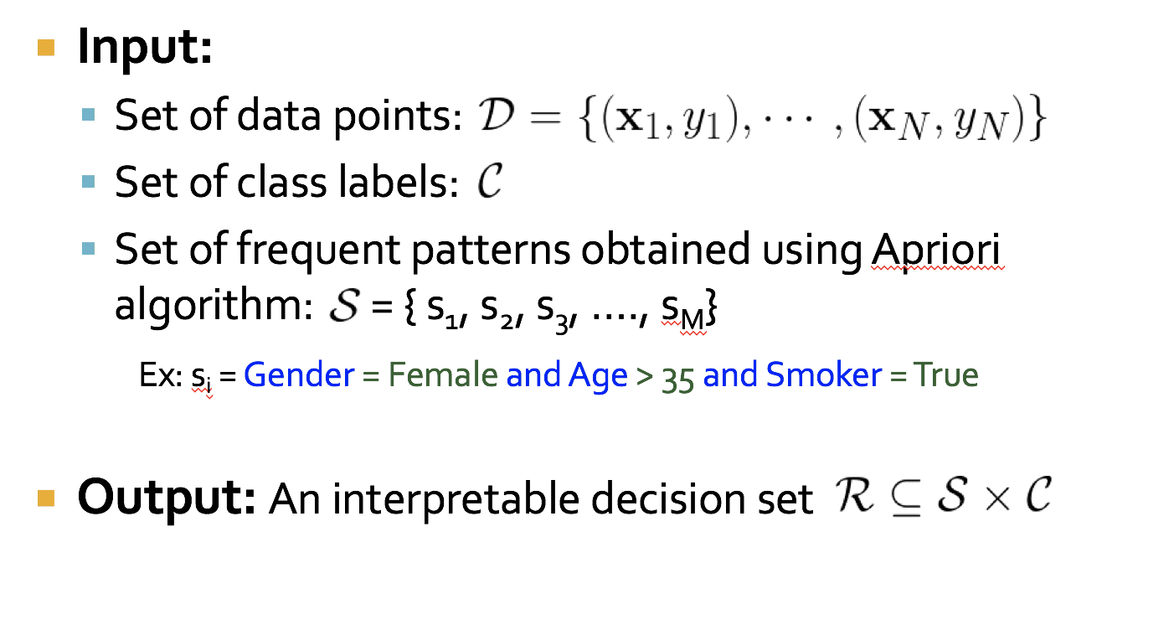
Problem Formulation

Slide 41
Desiderata
We need to optimize for the following criteria
  Recall
  Precision
  Distinctness
  Parsimony
  Class Coverage
Recall and Precision → Accurate predications
Distinctness, Parsimony, and Class Coverage →Interpretability

Slide 42
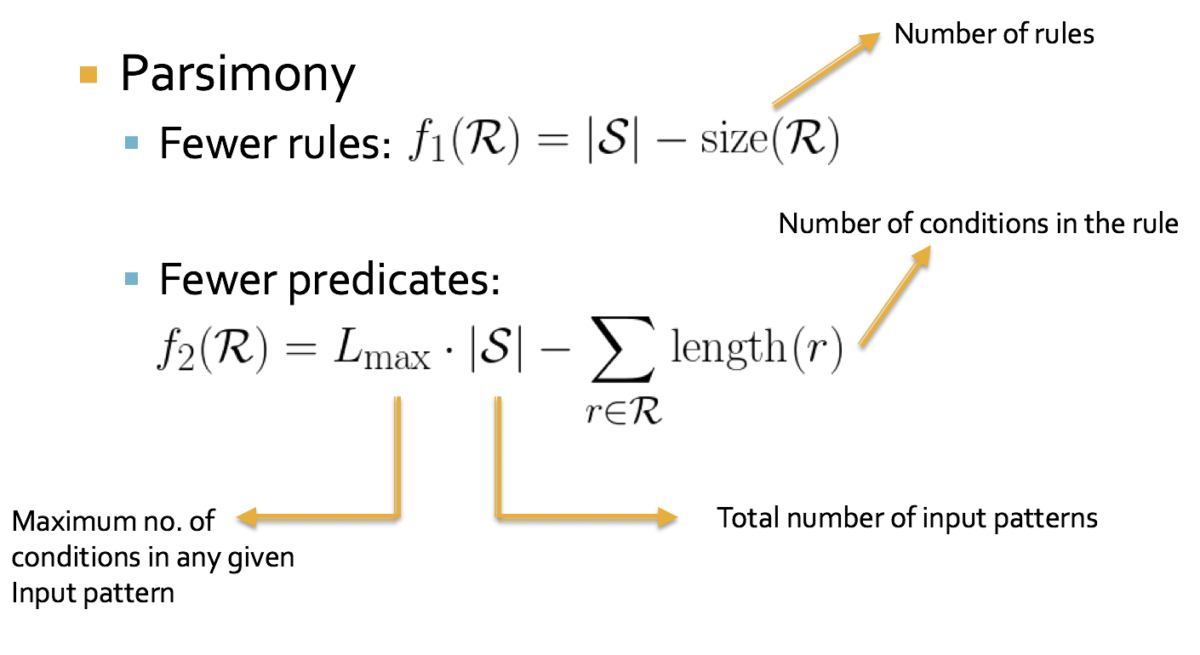
Objective Function

Slide 43
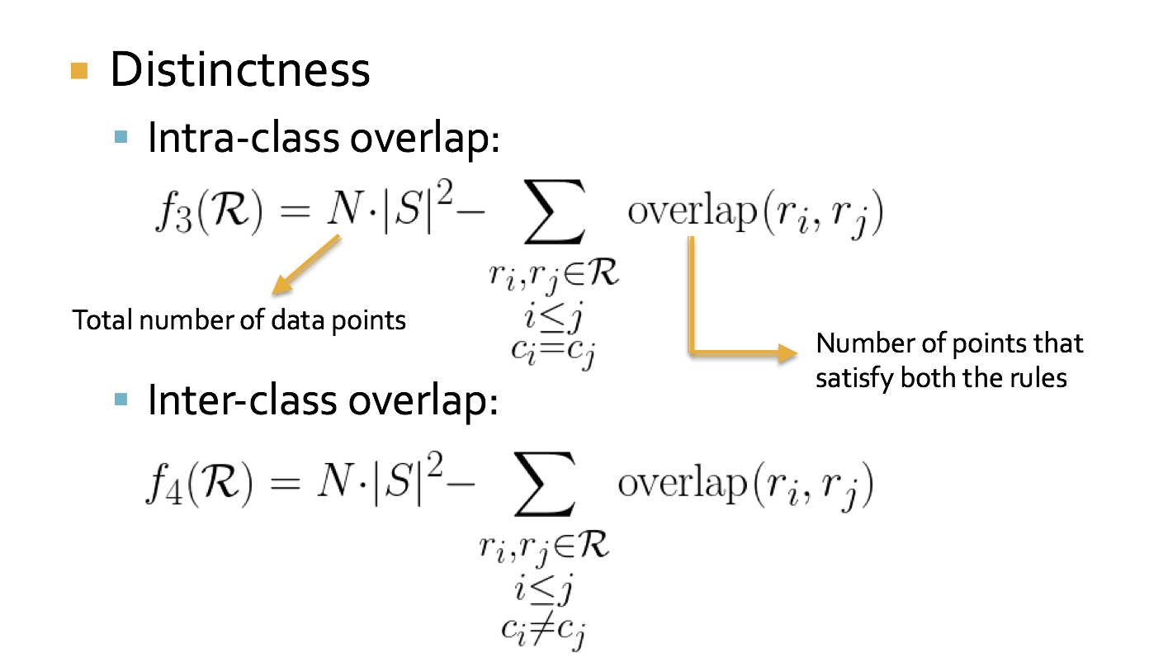
Objective Function

Slide 44
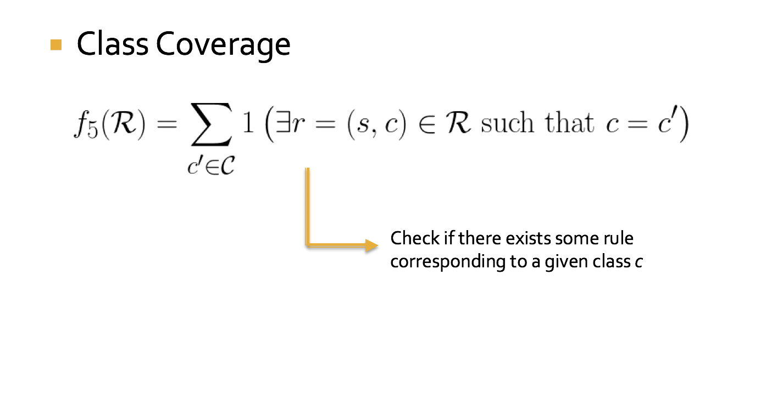
Objective Function

Slide 45
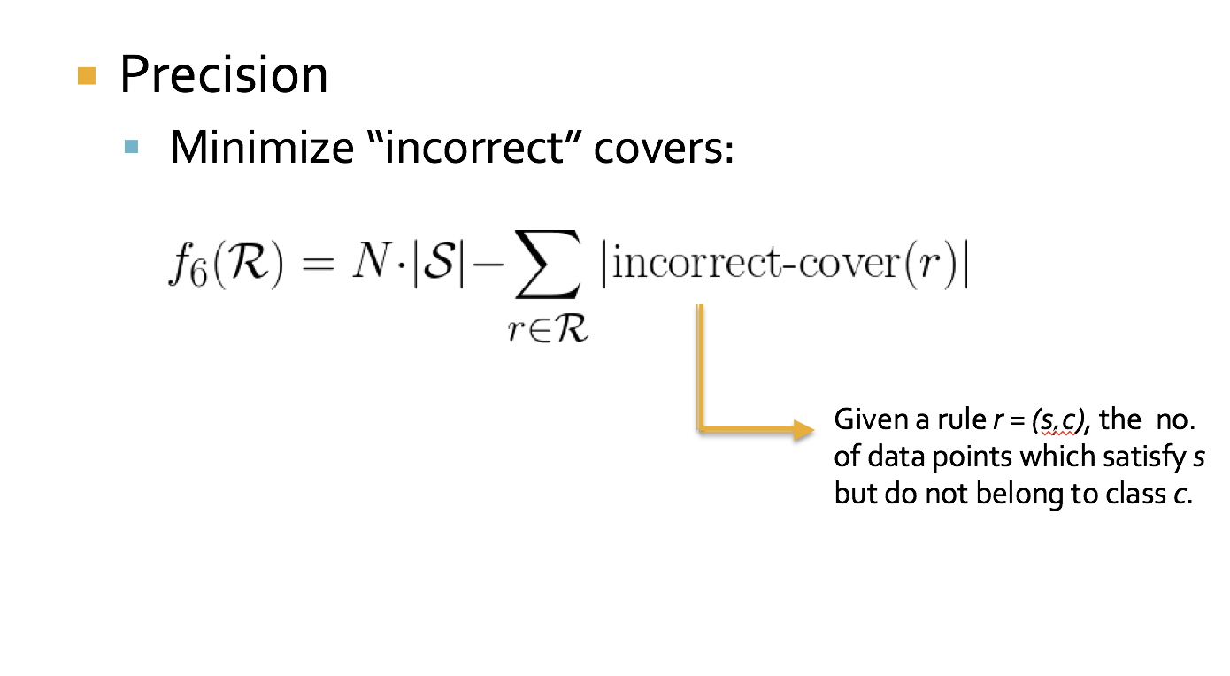
Objective Function

Slide 46
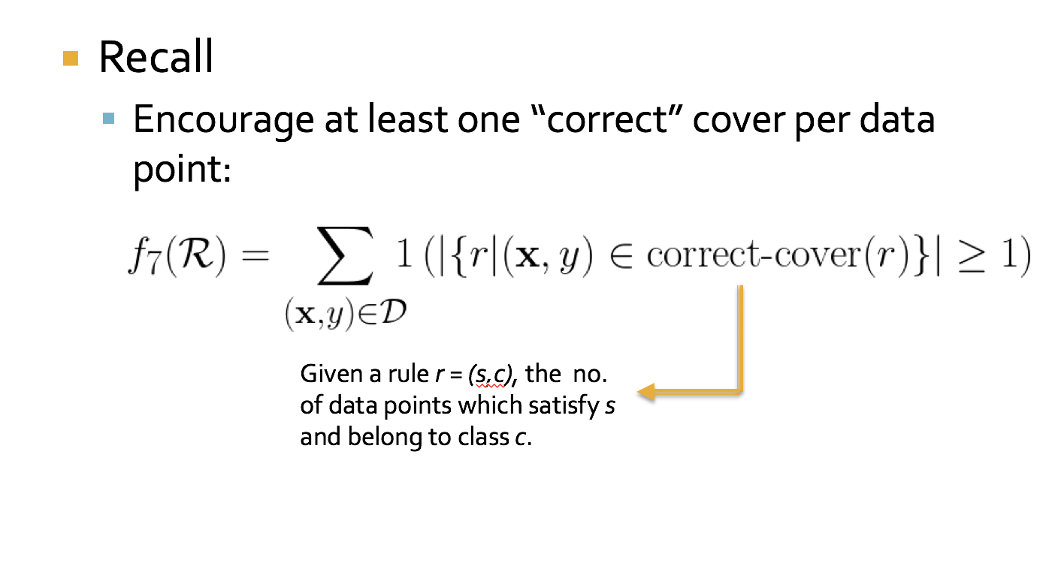
Objective Function

Slide 47
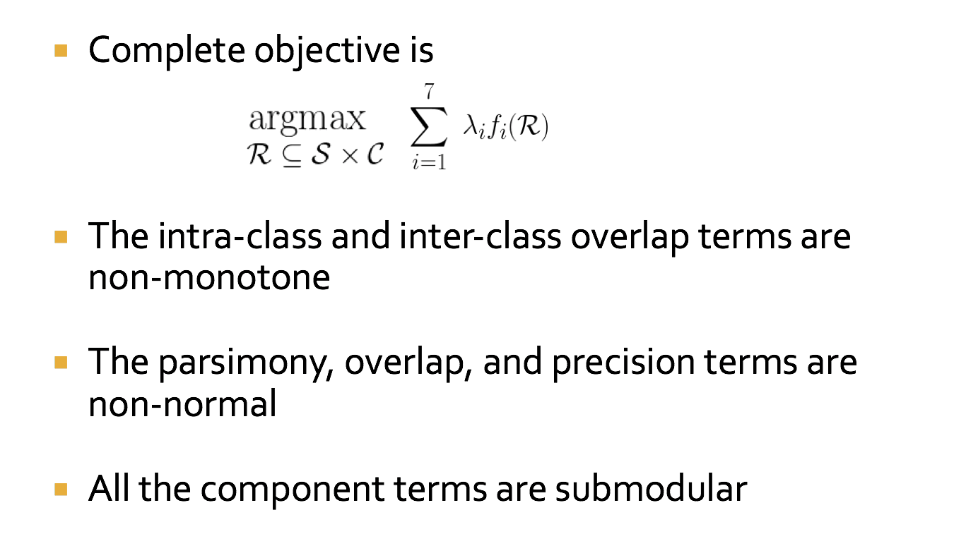
Objective Function

Slide 48
Submodularity
Diminishing returns characterization
F(A ∪ d) – F(A) ≥ F(B ∪ d) – F(B)
Gain of adding d to a small set
Gain of adding d to a large set
B
+
d
Large improvement
A
+
d
Small improvement
A non-negative linear combination of
submodular functions is submodular
Notes:
A \subset B

Slide 49
Objective Function
The complete objective is non-negative, non-normal, non-monotone, submodular

Slide 50
Optimizing the Objective
Maximizing a non-monotone submodular function is NP-hard
Smooth local search [SLS] algorithm provides a 2/5 approximation [Feige, Mirrokni, Vondrak FOCS 07; SIAM Comp. J. 11 ]
  Will be at least 2/5 of the optimal solution

Slide 51
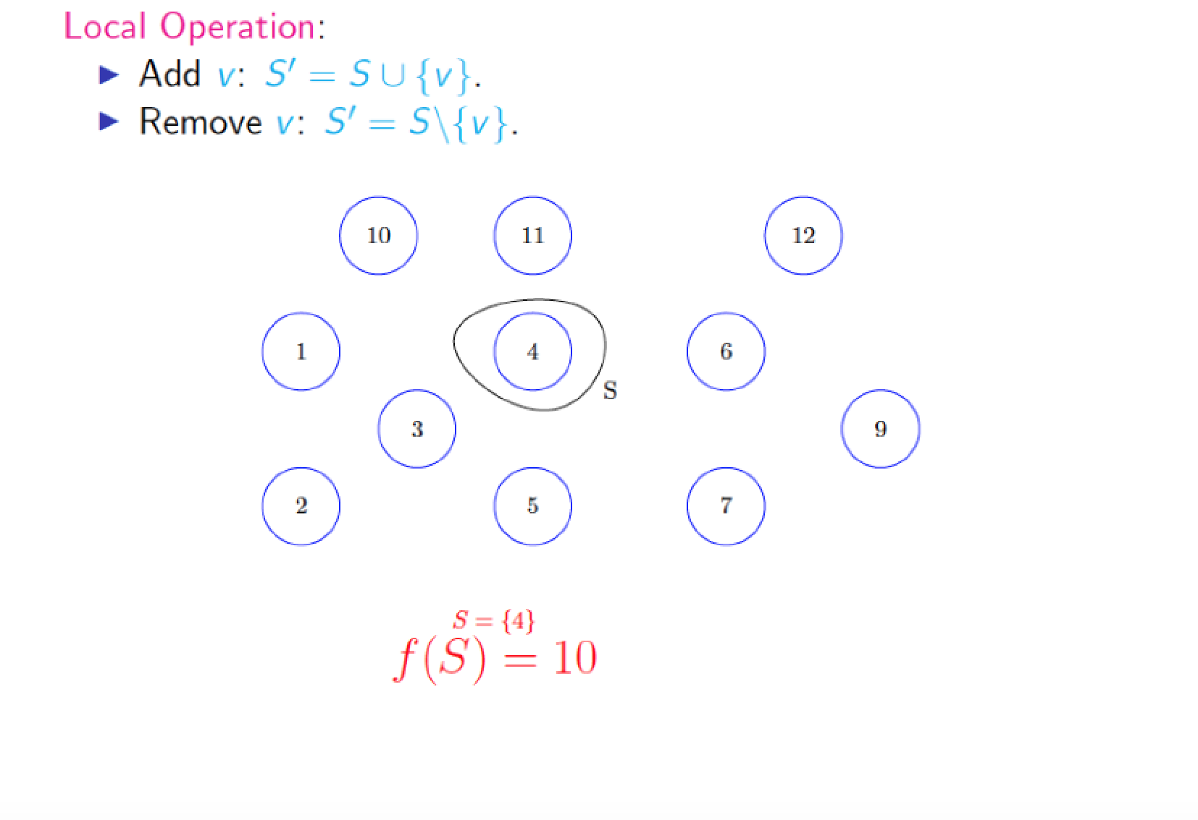
Submodular Maximization: Local Search
Each node here
corresponds to a
candidate
rule = (pattern, class) tuple
S and S’ correspond to the intermediate solution sets

Slide 52
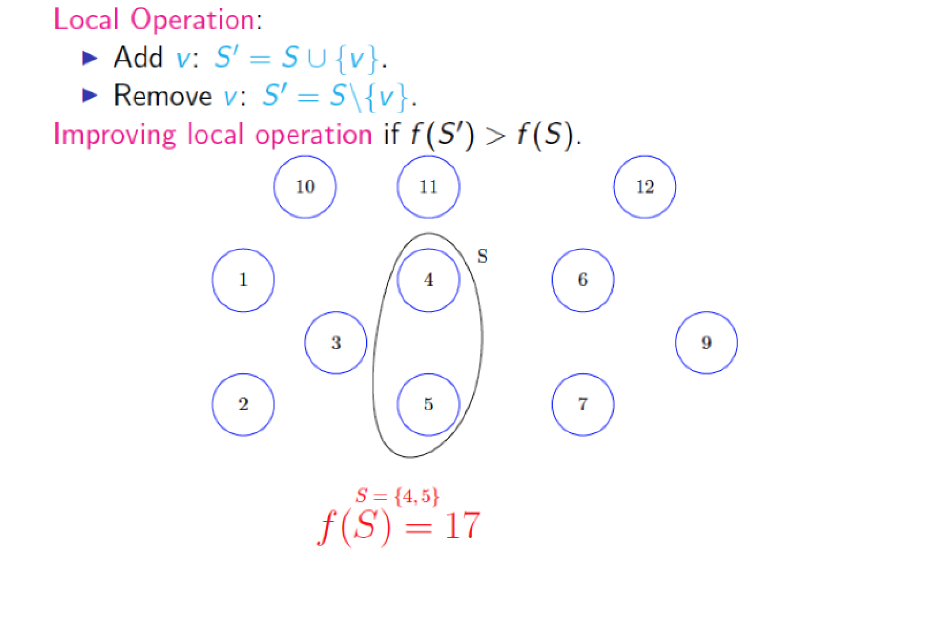
Submodular Maximization: Local Search
S and S’ correspond to the intermediate solution sets

Slide 53
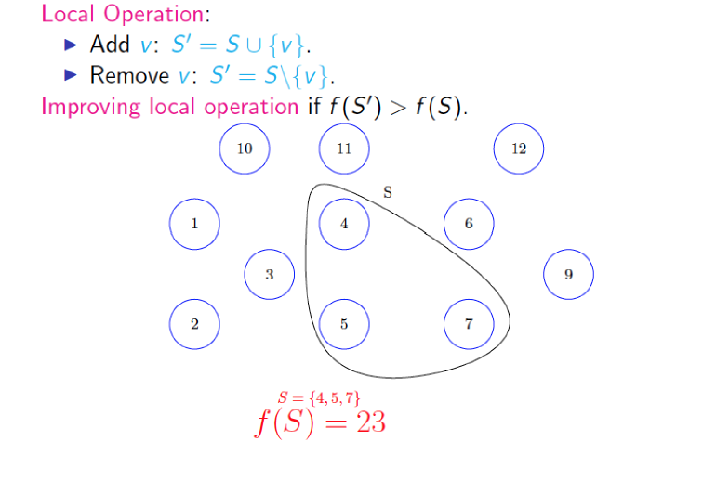
Submodular Maximization: Local Search
S and S’ correspond to the intermediate solution sets

Slide 54
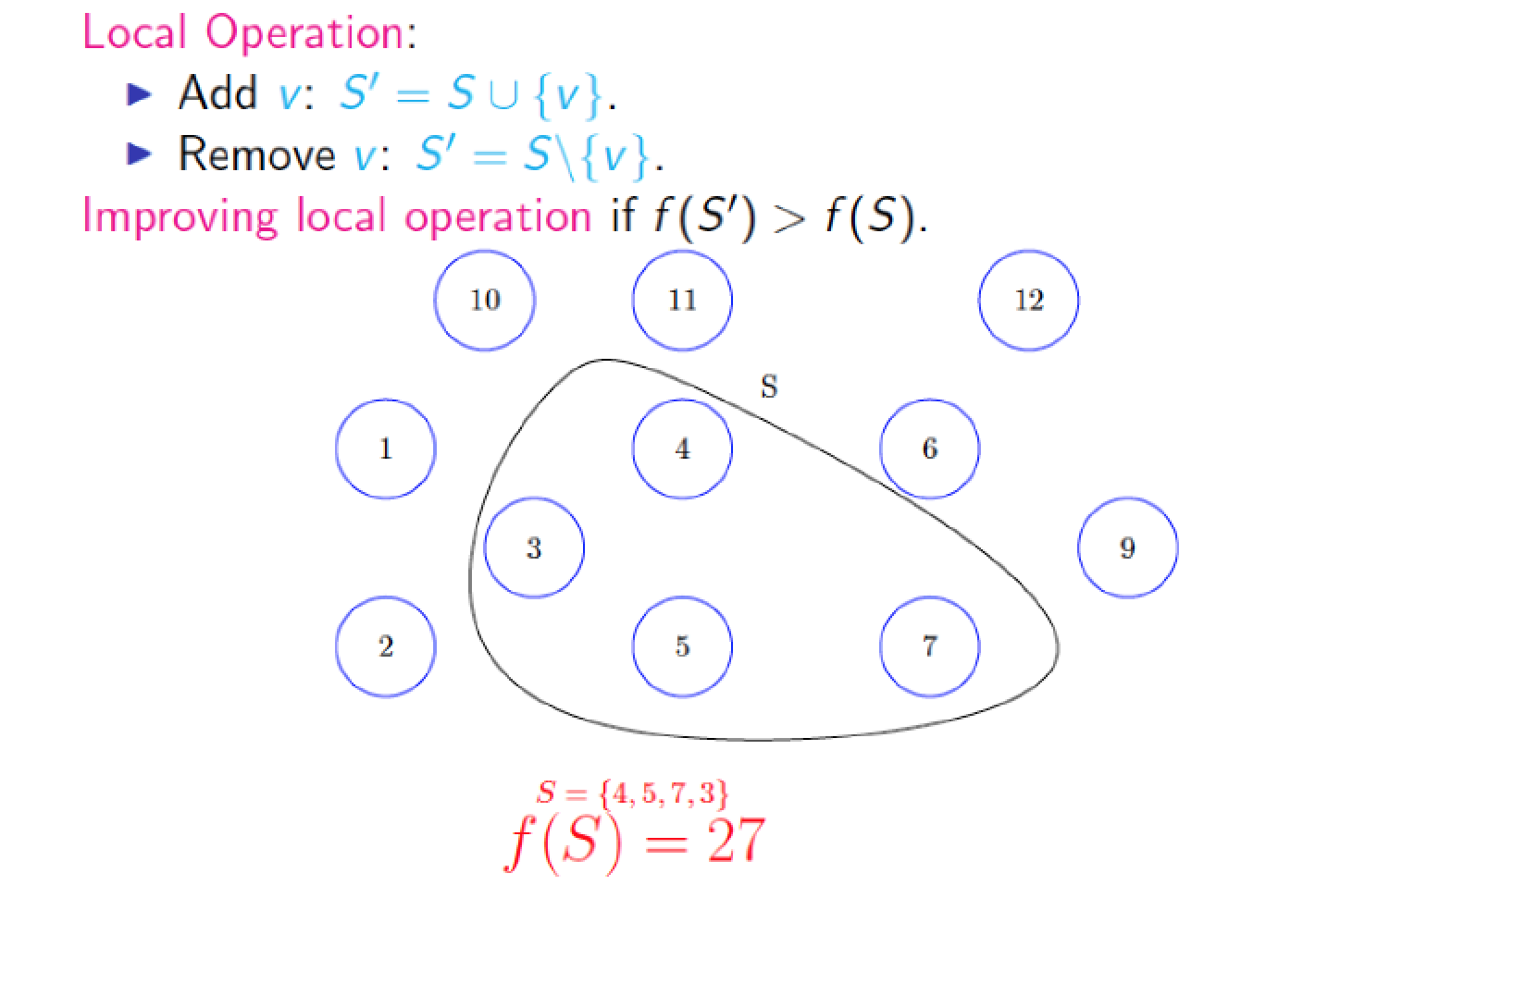
Submodular Maximization: Local Search
S and S’ correspond to the intermediate solution sets

Slide 55
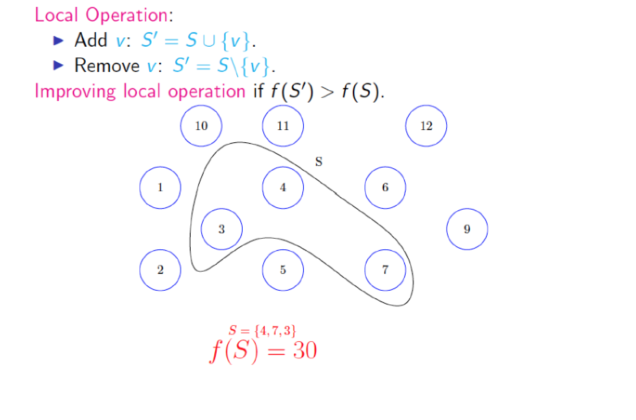
Submodular Maximization: Local Search
S and S’ correspond to the intermediate solution sets

Slide 56
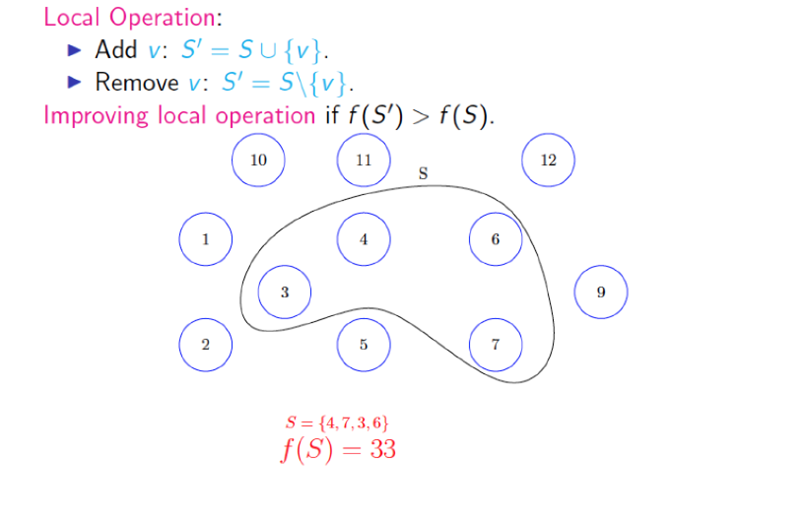
Submodular Maximization: Local Search
S and S’ correspond to the intermediate solution sets

Slide 57
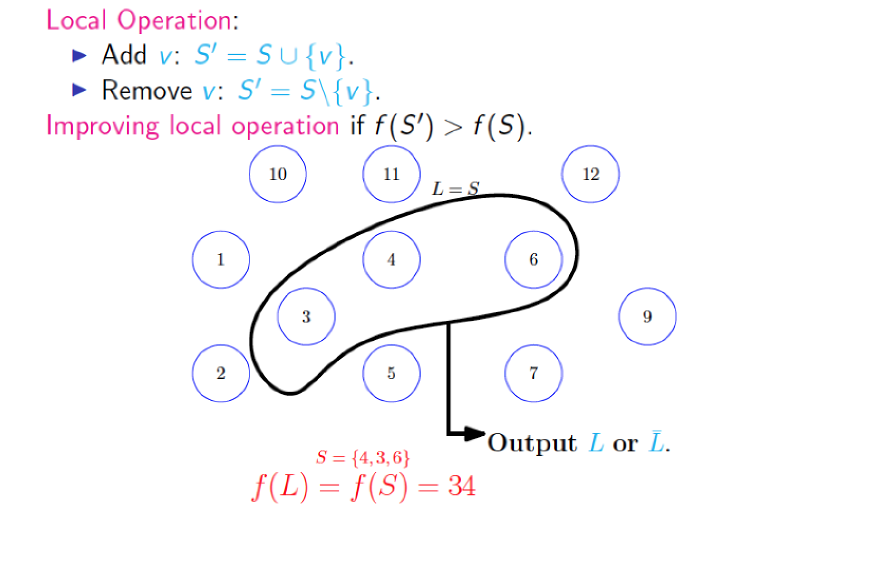
Submodular Maximization: Local Search
S and S’ correspond to the intermediate solution sets

Slide 58
Local Search
~1/3 approximation
  At least 1/3 of optimal solution
we use a slightly different version of this algorithm
  Smooth local search
  2/5 approximation

Slide 59
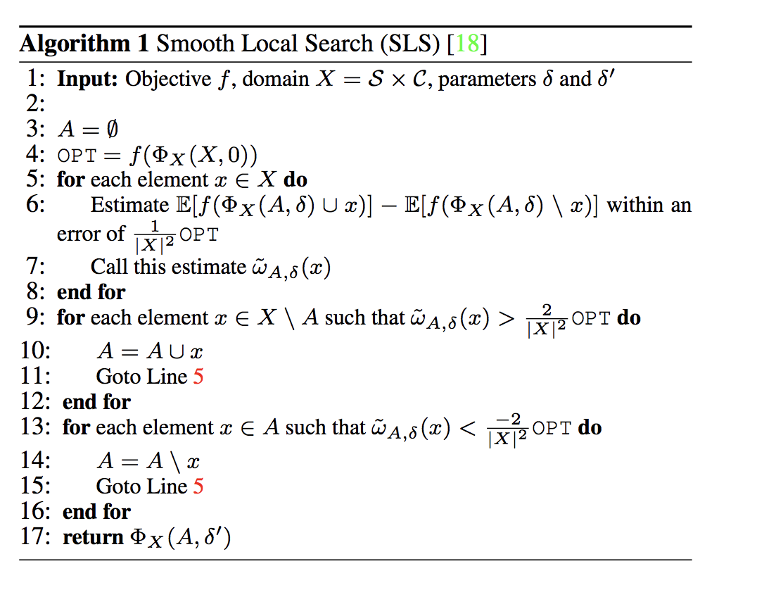
Smooth Local Search
Initialization
Marginal gain
If marginal gain > threshold,
Add element
If marginal gain < threshold,
Add element

Slide 60
Evaluation: Datasets
Dataset | # of datapoints | Features | Classes
Bail Outcomes | 86K | Gender, age, current offense details, past criminal record | No Risk, Failure to Appear, New Criminal Activity
Student Performance | 21K | Gender, age, grades, `absence rates & tardiness behavior through grades 6 to 8, suspension/withdrawal history | Graduated on Time, Delayed Graduation, Dropped out
Medical Diagnosis | 150K | Current ailments, age, BMI, gender, smoking habits, medical history, family history | Asthma, Diabetes, Depression, Lung Cancer, Rare Blood Cancer

Slide 61

Parameter Setting
Trade-off parameters
Initialize everything to 0
Validation set: 5% of dataset (does not overlap with train/test set)
Coordinate ascent:
  Keep all except one parameter constant
  Small increment to that one parameter
  See how AUC changes – if increases and does not violate constraints, then keep incrementing
Fraction Overlap <= 0.10, Fraction Uncovered <= 0.15, Avg. Rule Length <= 10, Number of rules <= 15, Fraction Classes = 1.0

Slide 62
Evaluating Predictive Performance
Method | AUC Bail Data | AUC Student Data | AUC Medical Data
Our Approach | 69.78 | 75.12 | 61.19
Bayesian Decision Lists (Letham et. al.) | 67.18 | 72.54 | 59.18
Classification Based on Association (Liu et. al.) | 70.68 | 76.02 | 63.03
CN2 | 71.02 | 76.36 | 64.78
Decision Trees | 70.08 | 75.31 | 63.28
Gradient Boosted Trees | 71.23 | 77.18 | 64.21
Random Forests | 70.87 | 77.12 | 63.92

Slide 63
Evaluating Goodness of Rules
Results on Medical Diagnosis Data
Method | Fraction of Overlap | Fraction of Data Points Uncovered | Avg. Rule Width | Num. Rules | Fraction of Classes Covered
Our Approach | 0.09 | 0.13 | 3.17 | 12 | 1.0
Bayesian Decision Lists (Letham et. al.) | 0.00 | 0.18 | 8.46 | 11 | 0.67
Classification Based on Association (Liu et. al.) | 0.00 | 0.14 | 8.60 | 32 | 1.00
CN2 | 0.12 | 0.14 | 9.78 | 38 | 1.00

Slide 64
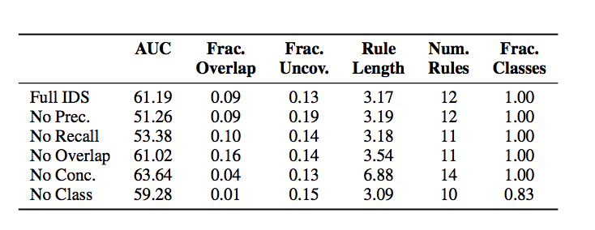
Ablation Study
Results on Medical Diagnosis Data

Slide 65
Evaluating Interpretability:
User Study
Compared our interpretable decision sets to Bayesian Decision Lists (Letham et. al.)
Each user is randomly assigned one of the two models
10 objective and 2 descriptive questions per user

Slide 66
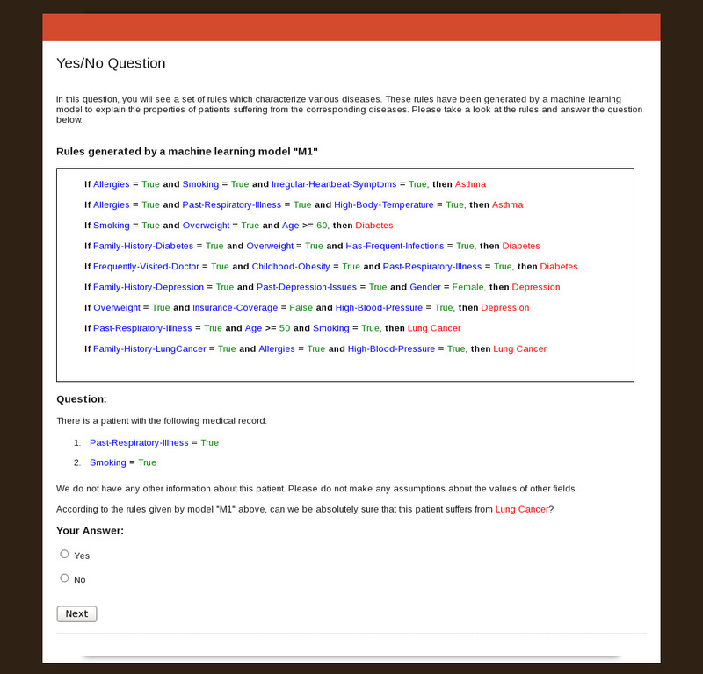
Interface for Objective Questions

Slide 67
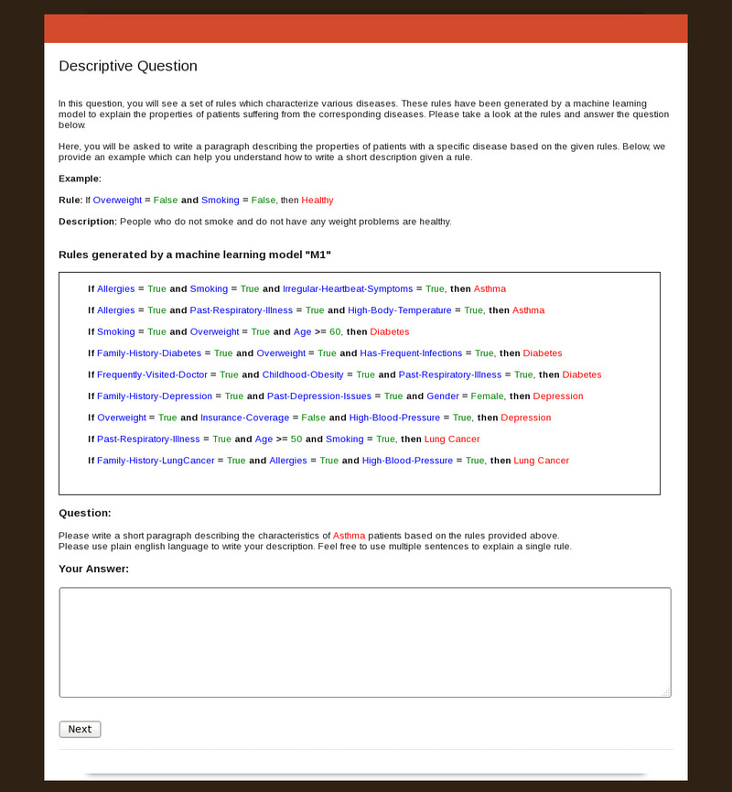
Interface for Descriptive Questions

Slide 68
User Study Results
Task | Metrics | Our Approach | Bayesian Decision Lists
Descriptive | Human Accuracy | 0.81 | 0.17
 | Avg. Time Spent (secs.) | 113.4 | 396.86
 | Avg. # of Words | 31.11 | 120.57
Objective | Human Accuracy | 0.97 | 0.82
 | Avg. Time Spent (secs.) | 28.18 | 36.34
Objective Questions: 17% more accurate, 22% faster;
Descriptive Questions: 74% fewer words, 71% faster.

