Slide 1
Understanding models via their training data
Understanding black-box predictions via influence functions. Koh and Liang, ICML 2017.
Slides by Pang Wei Koh

Slide 2

Prior work: Focus on test data
Training data
Training
Test data
Evaluation
Model

Slide 3
Prior work: Focus on test data
Training data
Training
Test data
Evaluation
Model

Slide 4
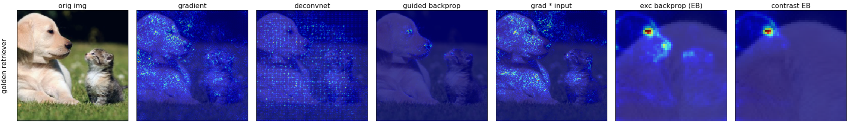
Which parts of the test input most affect the model’s prediction?
[Ruth Fong’s interpretability tutorial, 2019]
Class activation maps [Zhou et al., 2016]
Concept activation vectors [Kim et al., 2018]
DeConvNet [Zeiler & Fergus, 2014]
Deep Taylor decomposition [Montavon et al., 2017]
DeepLIFT [Shrikumar et al., 2017]
Deletion game [Fong & Vedaldi, 2017]
Generalized additive models [Caruana et al., 2015]
Gradients [Baehrens et al., 2010]
…
Guided BackProp [Springenberg et al., 2015]
Grad-CAM [Selvaraju et al., 2016]
Integrated Gradients [Sundararajan et al., 2017]
Layer-wise relevance propagation [Bach et al., 2015]
LIME [Ribeiro et al., 2016]
Saliency maps [Simonyan et al., 2014]
SHAP [Lundberg et al., 2017]
SmoothGrad [Smilkov et al., 2017]
…

Slide 5
Our work: Link model to training data
5
Training data
Training
Test data
Evaluation
Model

Slide 6

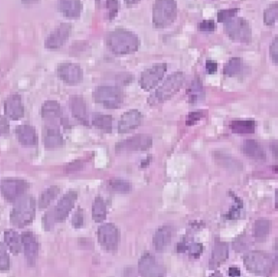


Example: Dataset debugging
Prediction
Normal
35%
Tumor
Test point $z_{test}$
Model $\hat{θ}$

Slide 7
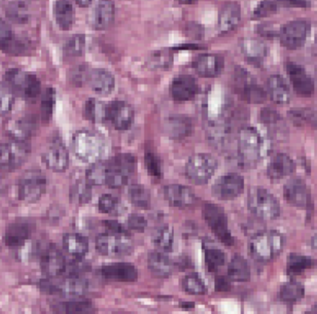
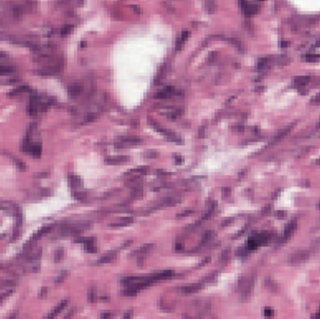
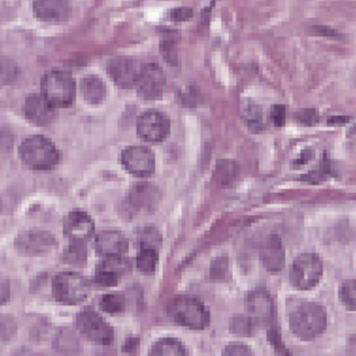
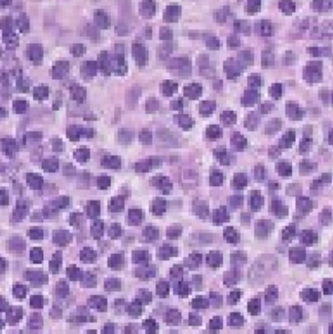

Tumor
Tumor
Normal
Normal
Training data $z_{1}, z_{2}, …, z_{n}$
Training
Prediction
Normal
35%
Tumor
Test point $z_{test}$
Model $\hat{θ}$

Slide 8

Tumor
Tumor
Tumor
Normal
Normal
Training data $z_{1}, z_{2}, …, z_{n}$
Training
Prediction
Normal
35%
Tumor
Test point $z_{test}$
Model $\hat{θ}$

Slide 9
Tumor
Tumor
Normal
Normal
Leave-one-out approach
Training data $z_{1}, z_{2}, …, z_{n}$
Training
[Quenouille,1956; Tukey, 1958]
Prediction
Normal
35%
Tumor
Test point $z_{test}$
Model $\hat{θ}$

Slide 10
Tumor
Tumor
Normal
Normal
Training data $z_{1}, z_{2}, …, z_{n}$
Training
Prediction
Normal
35%
Tumor
-4%
Test point $z_{test}$
Model $\hat{θ}$
Normal
31%
Tumor

Slide 11
Tumor
Tumor
Normal
Normal
Training data $z_{1}, z_{2}, …, z_{n}$
Training
Prediction
Normal
35%
Tumor
-2%
Test point $z_{test}$
Model $\hat{θ}$
Normal
33%
Tumor

Slide 12
Tumor
Tumor
Normal
Normal
Training data $z_{1}, z_{2}, …, z_{n}$
Training
Prediction
Normal
35%
Tumor
+40%
Test point $z_{test}$
Model $\hat{θ}$
Normal
75%
Tumor

Slide 13
Tumor
Tumor
Normal
Normal
Problem
Repeatedly removing training points and retraining is too slow
Solution
First-order Taylor approximation via influence functions
Training data $z_{1}, z_{2}, …, z_{n}$
Training
Prediction
Normal
35%
Tumor
+40%
Test point $z_{test}$
Model $\hat{θ}$
Normal
75%
Tumor

Slide 14

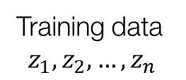





Tumor
Tumor
Normal
Normal
Training data
$$z_{1}, z_{2}, …, z_{n}$$
Training
Weights
$$1$$
$$1$$
$$1$$
$$1$$
Test point $z_{test}$
Model $\hat{θ}$

Slide 15


Tumor
Tumor
Normal
Normal
Training data
$$z_{1}, z_{2}, …, z_{n}$$
Training
Weights
$$0$$
$$1$$
$$1$$
$$1$$
Test point $z_{test}$
Model ${\hat{θ}}_{−1}$

Slide 16



Change in prediction
(on test point)
Slow
Actual change
Fast
Estimated change
Weight
(on training point)
$$0$$
$$0$$
$$1$$
Original model

Slide 17

The influence function approximation
$$ℓ\left(z_{test},{\hat{θ}}_{−z_{train}}\right)−ℓ\left(z_{test},\hat{θ}\right)≈∇_{θ}ℓ{\left(z_{test},\hat{θ}\right)}^{T}H_{\hat{θ}}^{−1}∇_{θ}ℓ(z_{train},\hat{θ})$$
Loss on $z_{test}$
(original)

Slide 18
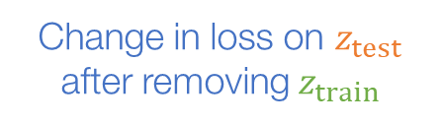
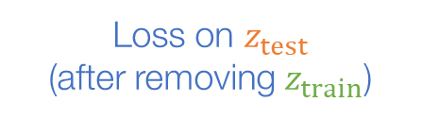
The influence function approximation
Change in loss on $z_{test}$ after removing $z_{train}$
$$ℓ\left(z_{test},{\hat{θ}}_{−z_{train}}\right)−ℓ\left(z_{test},\hat{θ}\right)≈∇_{θ}ℓ{\left(z_{test},\hat{θ}\right)}^{T}H_{\hat{θ}}^{−1}∇_{θ}ℓ(z_{train},\hat{θ})$$
Loss on $z_{test}$
(after removing $z_{train}$)
Loss on $z_{test}$
(original)

Slide 19
The influence function approximation
Change in loss on $z_{test}$ after removing $z_{train}$
$$ℓ\left(z_{test},{\hat{θ}}_{−z_{train}}\right)−ℓ\left(z_{test},\hat{θ}\right)≈∇_{θ}ℓ{\left(z_{test},\hat{θ}\right)}^{T}H_{\hat{θ}}^{−1}∇_{θ}ℓ(z_{train},\hat{θ})$$

Slide 20
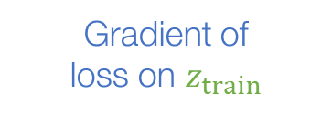
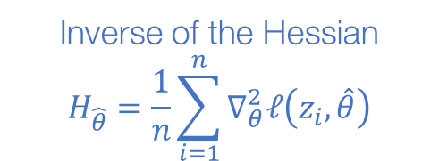
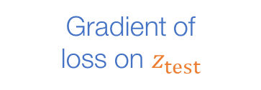
The influence function approximation
Change in loss on $z_{test}$ after removing $z_{train}$
$$ℓ\left(z_{test},{\hat{θ}}_{−z_{train}}\right)−ℓ\left(z_{test},\hat{θ}\right)≈∇_{θ}ℓ{\left(z_{test},\hat{θ}\right)}^{T}H_{\hat{θ}}^{−1}∇_{θ}ℓ(z_{train},\hat{θ})$$
Gradient of
loss on $z_{test}$
Gradient of
loss on $z_{train}$
Inverse of the Hessian
$$H_{\hat{θ}}^{ }=\frac{1}{n}\sum_{i=1}^{n}{∇_{θ}^{2}ℓ\left(z_{i},\hat{θ}\right)}$$

Slide 21
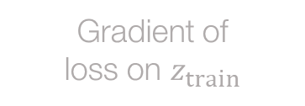
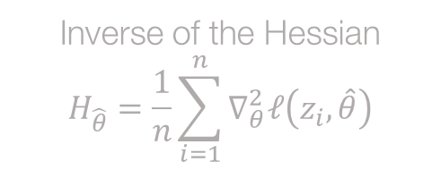
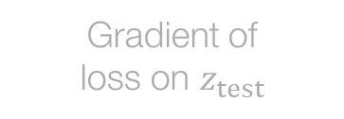
The influence function approximation
Doesn’t require retraining!
Change in loss on $z_{test}$ after removing $z_{train}$
$$ℓ\left(z_{test},{\hat{θ}}_{−z_{train}}\right)−ℓ\left(z_{test},\hat{θ}\right)≈∇_{θ}ℓ{\left(z_{test},\hat{θ}\right)}^{T}H_{\hat{θ}}^{−1}∇_{θ}ℓ(z_{train},\hat{θ})$$
Gradient of
loss on $z_{test}$
Gradient of
loss on $z_{train}$
Inverse of the Hessian
$$H_{\hat{θ}}^{ }=\frac{1}{n}\sum_{i=1}^{n}{∇_{θ}^{2}ℓ\left(z_{i},\hat{θ}\right)}$$

Slide 22
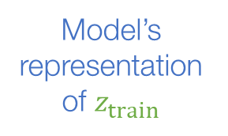
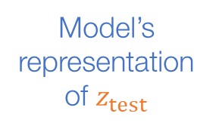
The influence function approximation
Effect of other training points
Model’s representation of $z_{test}$
Model’s representation of $z_{train}$
Change in loss on $z_{test}$ after removing $z_{train}$
$$ℓ\left(z_{test},{\hat{θ}}_{−z_{train}}\right)−ℓ\left(z_{test},\hat{θ}\right)≈∇_{θ}ℓ{\left(z_{test},\hat{θ}\right)}^{T}H_{\hat{θ}}^{−1}∇_{θ}ℓ(z_{train},\hat{θ})$$
Gradient of
loss on $z_{test}$
Gradient of
loss on $z_{train}$
Inverse of the Hessian
$$H_{\hat{θ}}^{ }=\frac{1}{n}\sum_{i=1}^{n}{∇_{θ}^{2}ℓ\left(z_{i},\hat{θ}\right)}$$

Slide 23


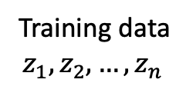


A little bit more technical details …
Training data
$$\hat{θ}$$
$$ℓ\left(z_{test},\hat{θ}\right)$$
Tumor
Tumor
Normal
Training data
$$z_{1}, z_{2}, …, z_{n}$$
Weights
$1$ + 𝝐
$$1$$
$$1$$
$$z$$

Slide 24
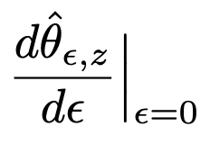
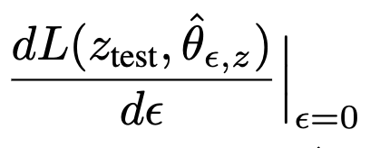
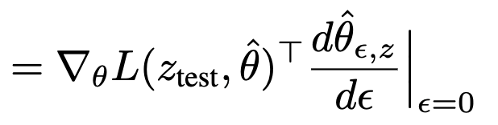
A little bit more technical details …
Training data
$$\hat{θ}$$
$$ℓ\left(z_{test},\hat{θ}\right)$$

Slide 25

From classical to modern settings
Jaeckel, 1972. The infinitesimal jackknife.
Hampel, 1974. The influence curve and its role in robust estimation.
Cook, 1977. Detection of influential observations in linear regression.
…

Slide 26
From classical to modern settings
Small datasets
Low-dimensional
Large datasets
High-dimensional
Difficult to compute
$$∇_{θ}ℓ{\left(z_{test},\hat{θ}\right)}^{T}H_{\hat{θ}}^{−1}∇_{θ}ℓ(z_{train},\hat{θ})$$
We use tools from
2nd-order optimization & stochastic estimation
[Pearlmutter, 1994; Martens, 2010, Agarwal et al., 2017]

Slide 27
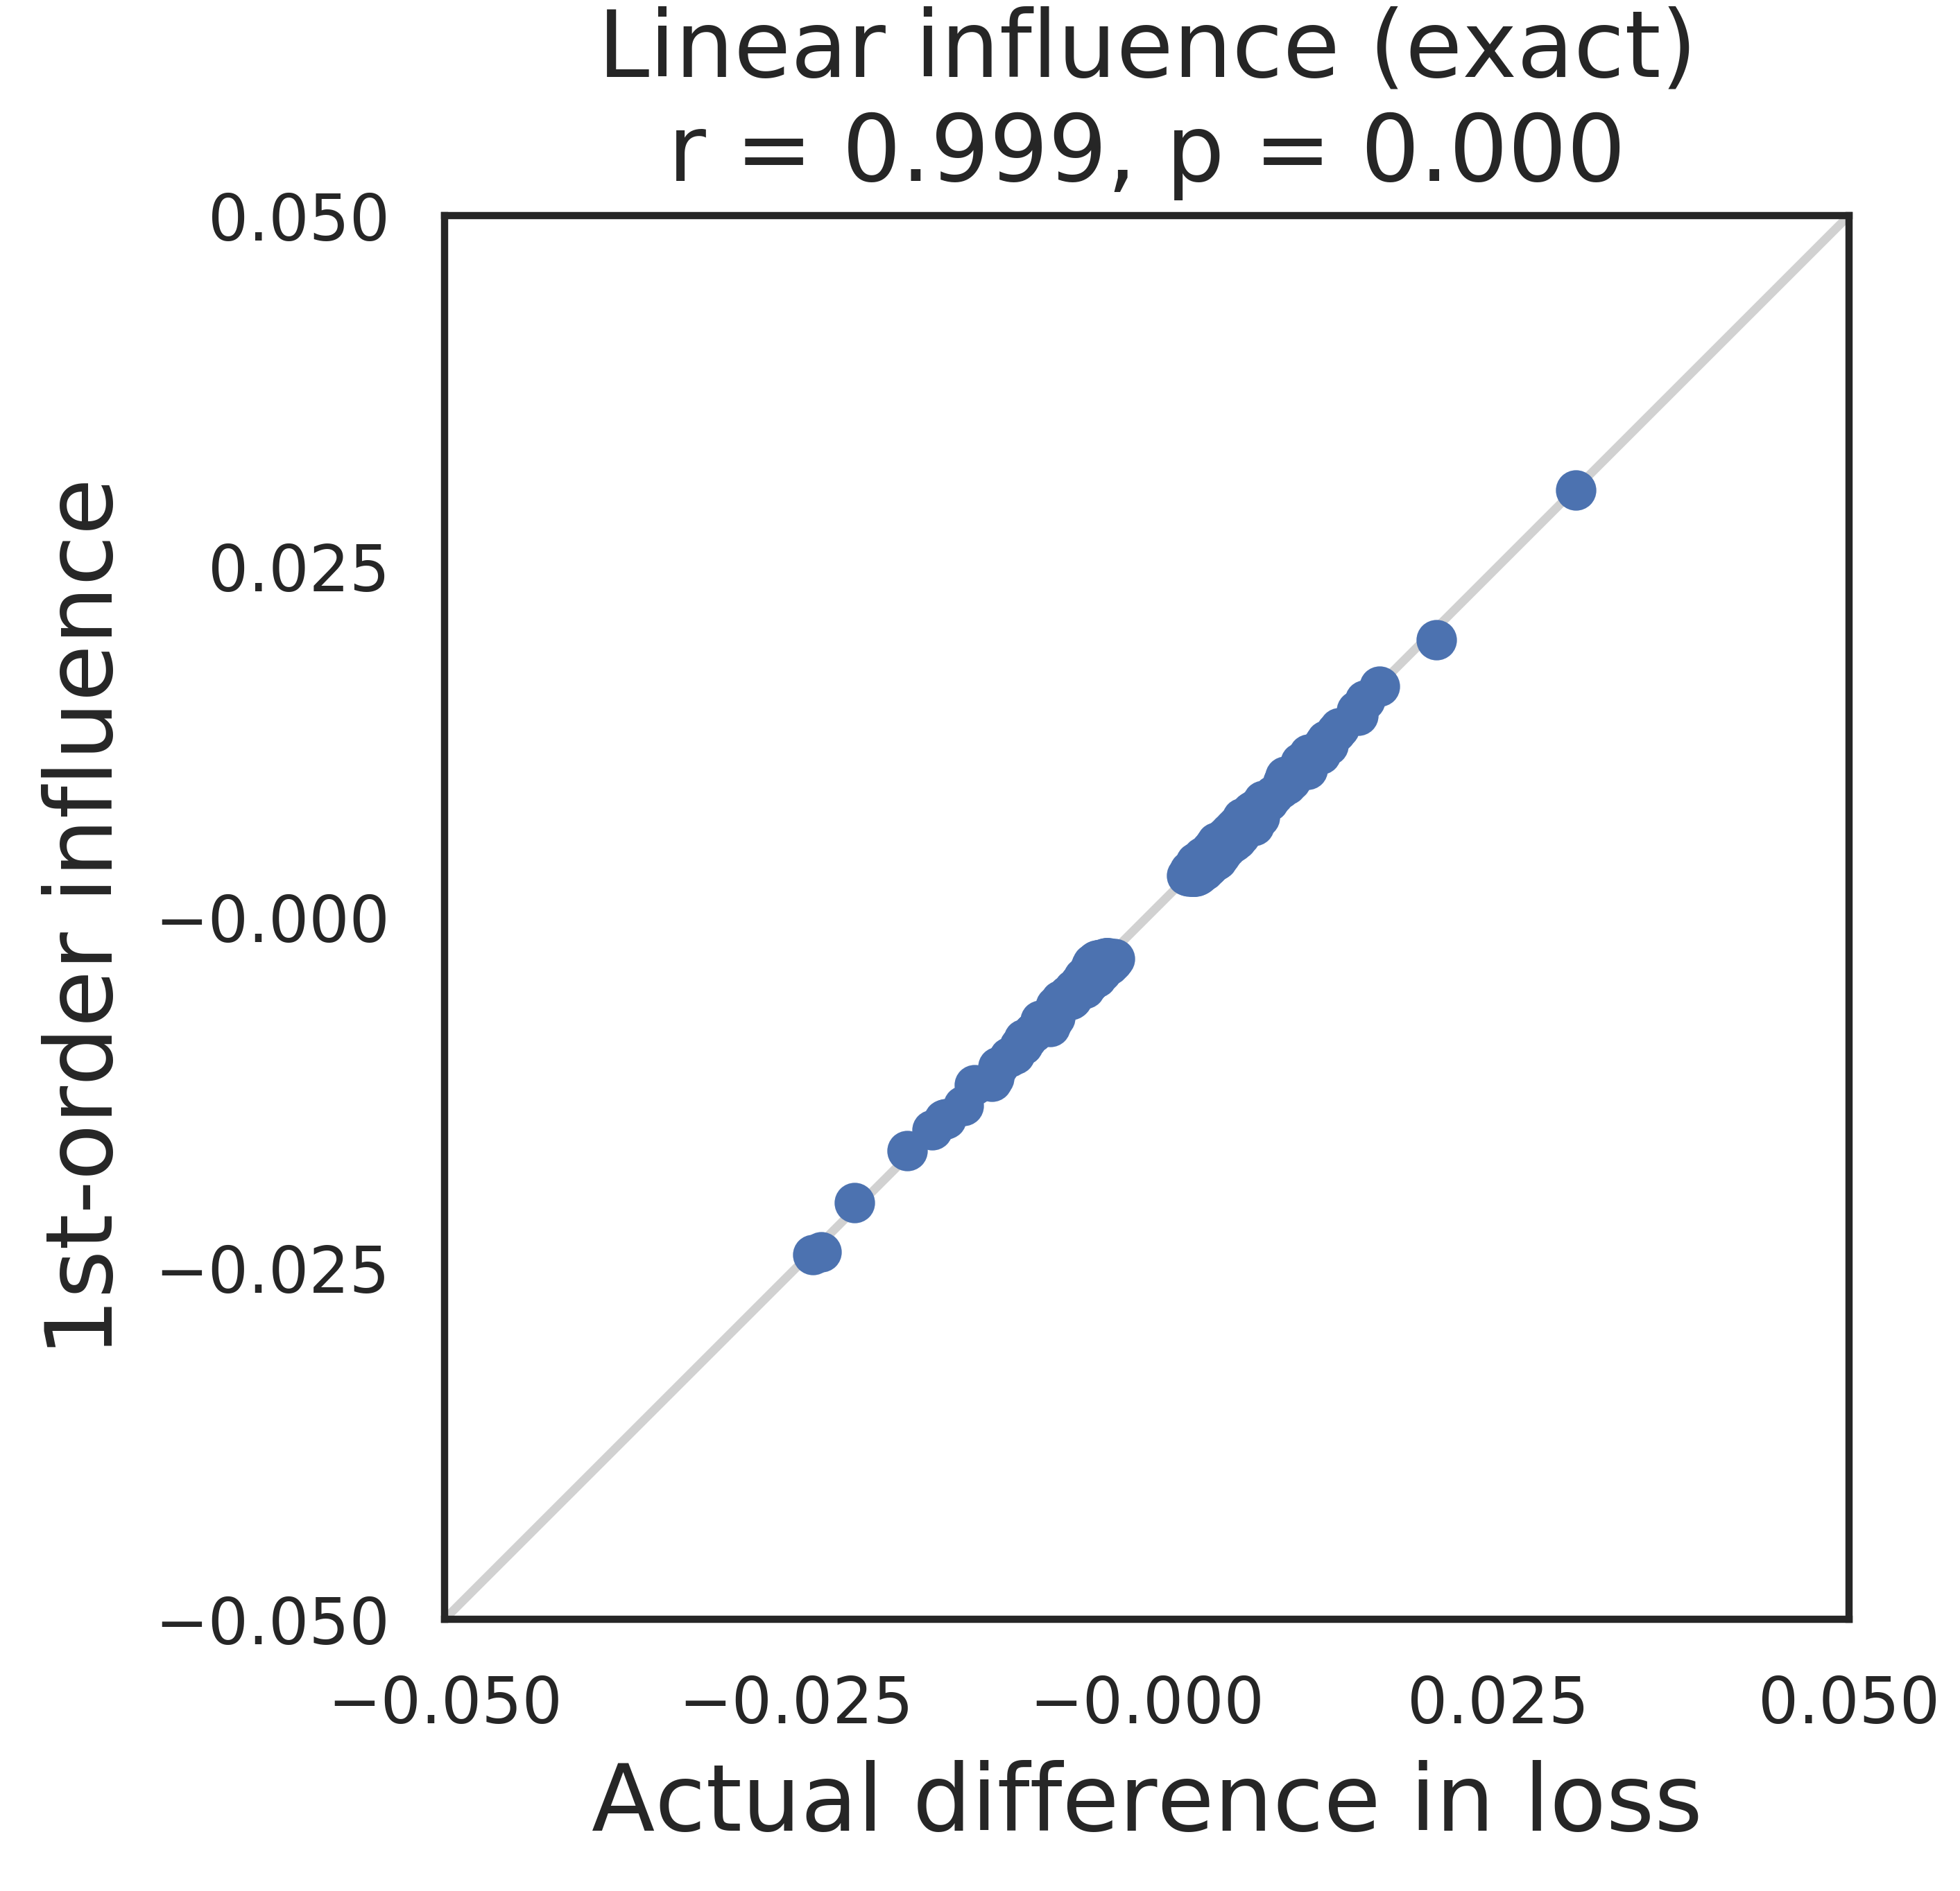
Removing single points
Logistic regression (MNIST)
Estimated
change
in test loss
(via influence functions)
Each point represents removing one training example
Actual change in test loss

Slide 28
Understanding Models via Their Training Data
Training data
Influence functions
Training
Test data
Evaluation
Where can you apply influence functions?

Slide 29
Impact
Robustness
Training set biases
[Ren et al., 2018]
Inference reliability
[Broderick et al., 2021]
Cross-validation
[Stephenson et al., 2020]
Memorization
[Feldman, 2019]
Applications
Data distillation
[Wang et al., 2020]
Data valuation
[Jia et al., 2019]
Active learning
[Gudovskiy et al., 2020]
Data debugging
[Guo et al., 2021]
Fairness & security
Algorithmic bias
[Verma et al., 2021]
Data labor
[Arrieta-Ibarra, 2018]
Privacy
[Shokri et al., 2021]
Data poisoning
[Chen et al., 2017]

Slide 30


Limitations
What assumptions on the models are needed to calculate influence functions?
Can you calculate influence functions for a neural network with the recipe described earlier?
Training data
$$\hat{θ}$$
$$ℓ\left(z_{test},\hat{θ}\right)$$

Slide 31
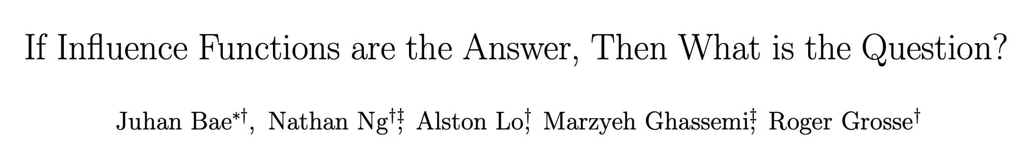
Limitations
What assumptions on the models are needed to calculate influence functions?
Can you calculate influence functions for a neural network with the recipe described earlier?
Non-convexity
Non-convergence

Slide 32
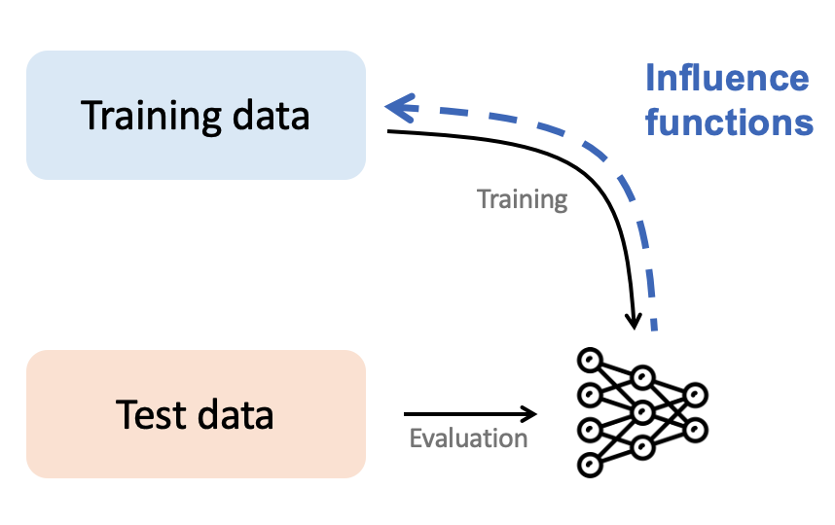
Summary
Link model behavior to training data
Efficient to calculate
Many applications
Limitations when applying to complex models

